Slide 1
Learning About the World around us Visual System
Part 2 of the book
Kavita Vemuri

Slide 2
The Eye and Light

Slide 3
The visual system
Color
Shapes
Depth
Motion
Texture
??

Slide 4
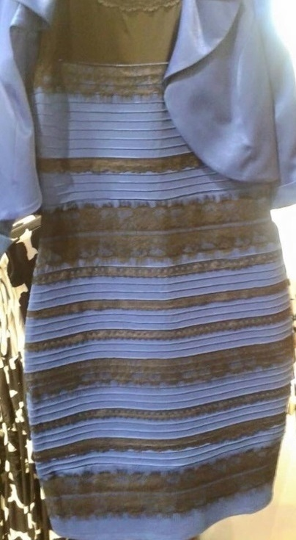


Slide 5


Slide 7
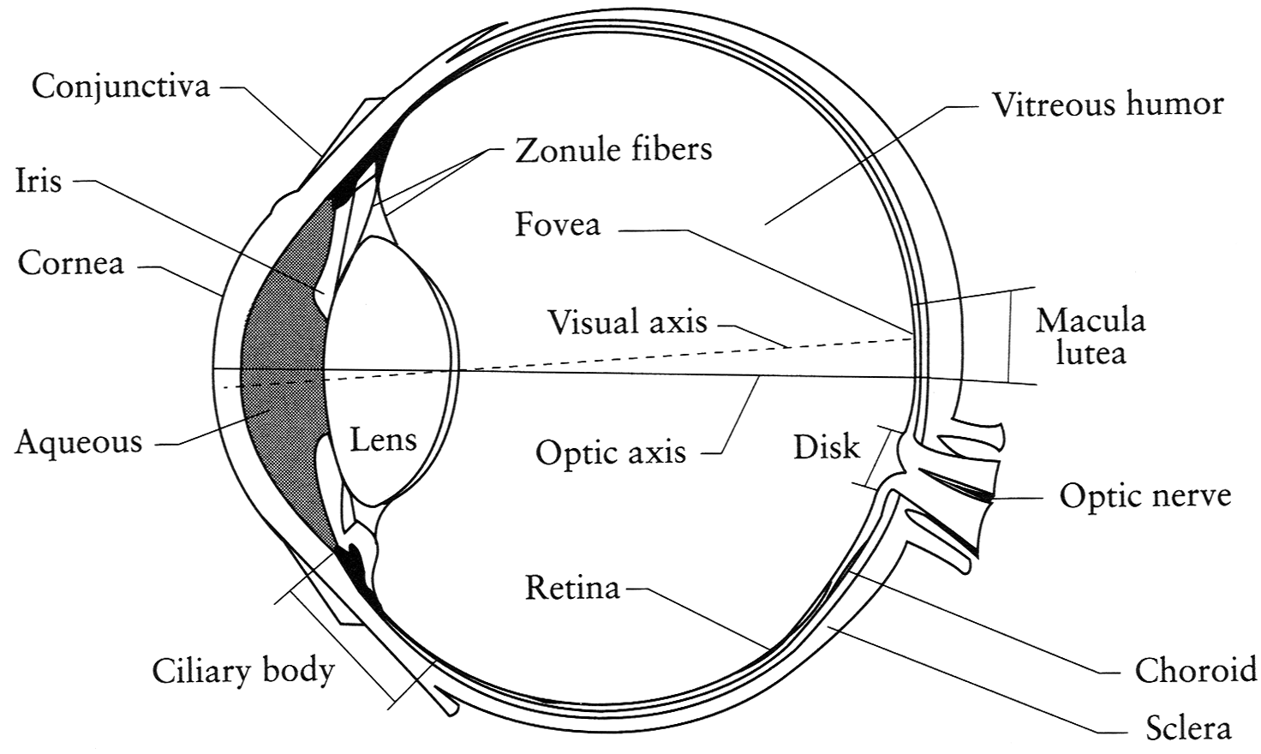
The Eye is a camera?
The camera is designed as the eye!
Iris - colored annulus with radial muscles
Pupil - the hole (aperture) whose size is controlled by the iris
What’s the “film”?
photoreceptor cells (rods and cones) in the retina

Slide 8
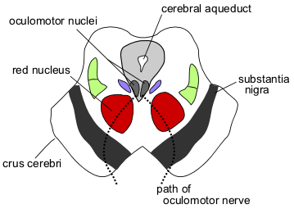
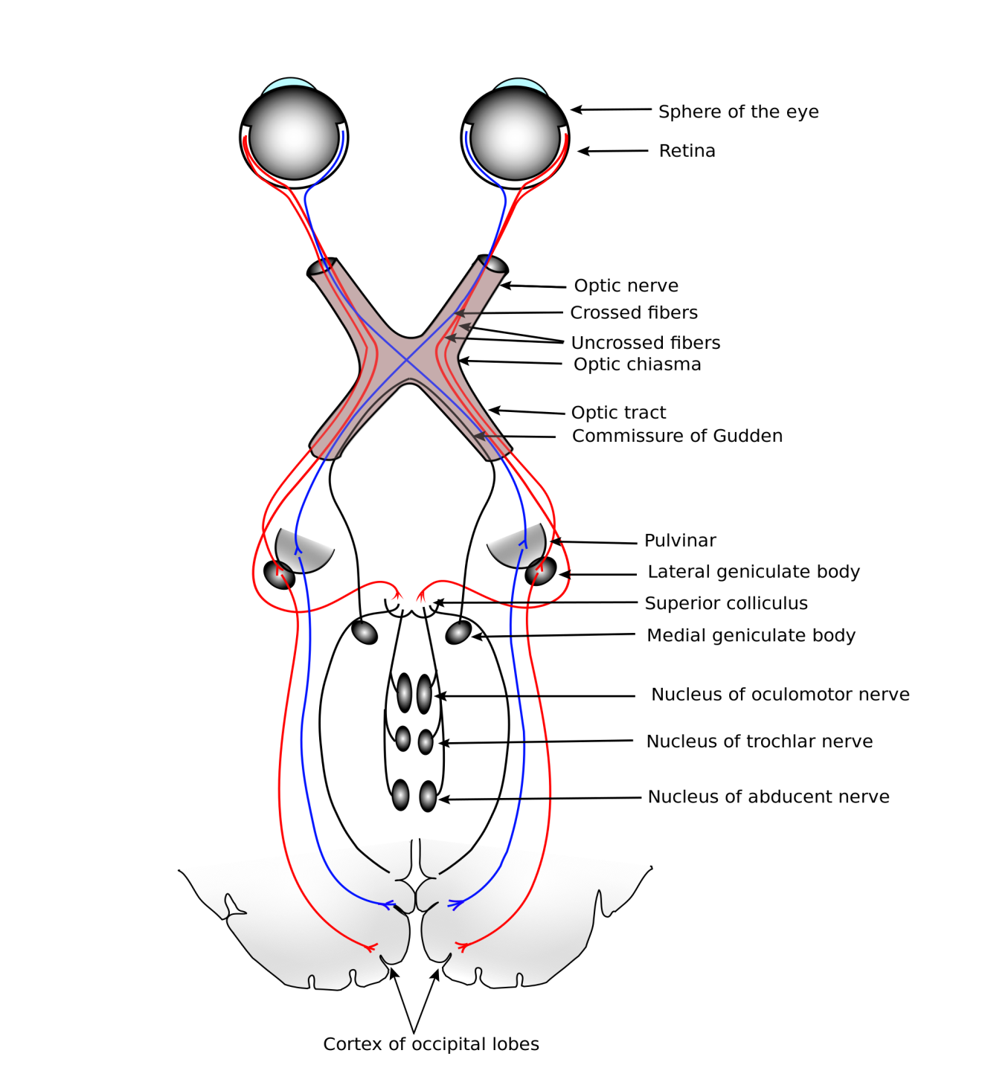
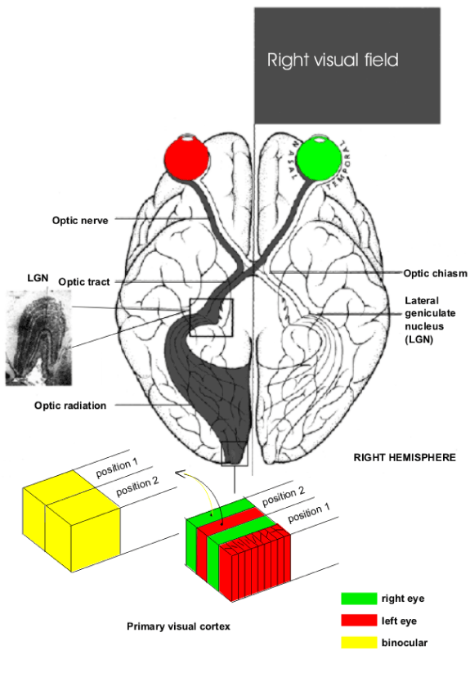
Pathway to Visual Cortex
Saccades
/Eye movements
© Stephen E. Palmer, 2002

Slide 9
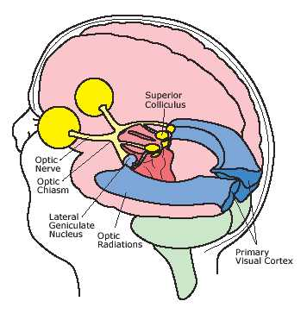
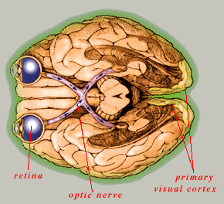
The Visual System
Both eye and brain are required for
functional vision
Two kinds of blindness:
Normal blindness (eye dysfunction)
Cortical blindness (brain dysfunction)
© Stephen E. Palmer, 2002
© Stephen E. Palmer, 2002

Slide 10
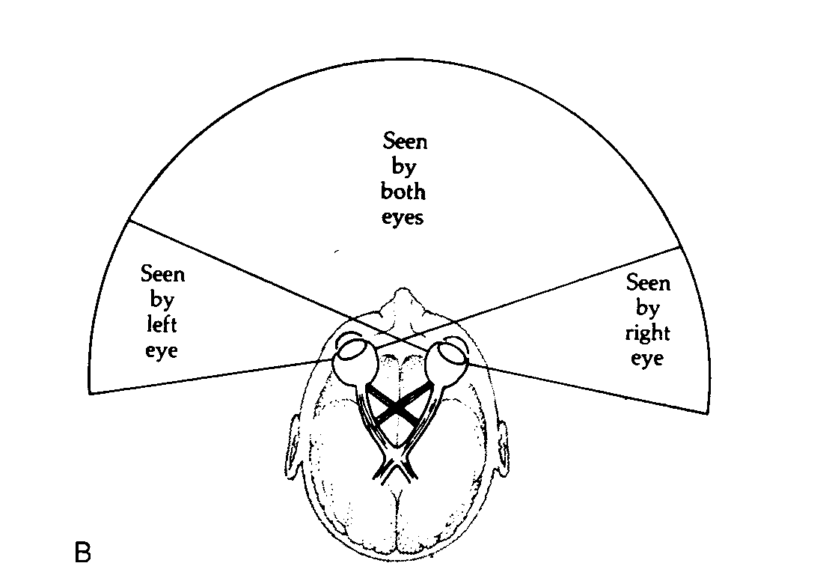
Monocular Visual Field: 160 deg (w) X 135 deg (h) Binocular Visual Field: 200 deg (w) X 135 deg (h)

Slide 11
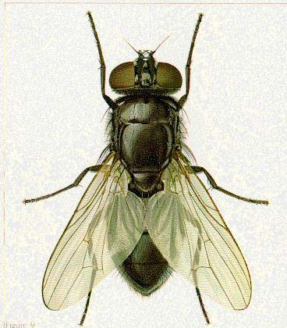


The Visual Grasp Reflex moves the eyes towards a suddenly appearing peripheral signal

Slide 12
The Retina

Slide 13
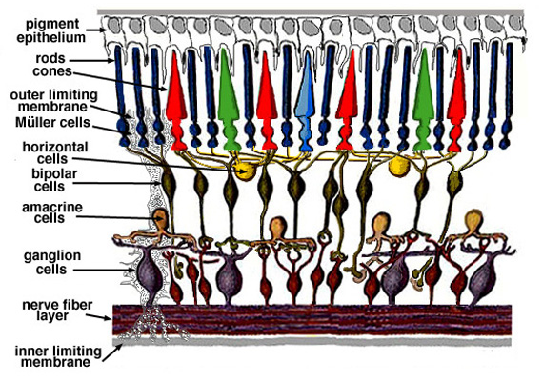
Retina up-close
Light

Slide 14
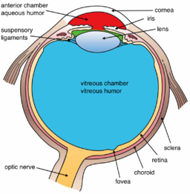
Two types of light-sensitive receptors
Cones
cone-shaped
less sensitive
operate in high light
color vision
Rods
rod-shaped
highly sensitive
operate at night
gray-scale vision
0.3 mm diameter rod-free area
Retina is organized into macula, optic disc, fovea and peripheral retina
© Stephen E. Palmer, 2002

Slide 15
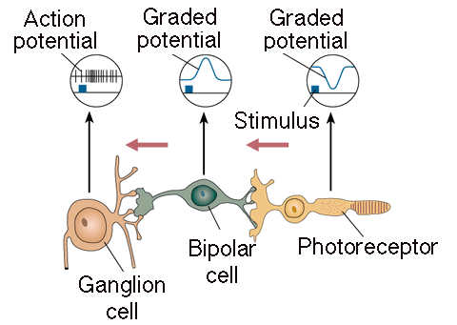
Retinal Receptive Fields
Receptive field structure in bipolar cells
Only Graded potential
Light
Only action potential
© Stephen E. Palmer, 2002

Slide 16
Transmission from the eye.
Light or darkness cause changes in neurotransmitter release
in photoreceptors.
Bipolar cells become either hyperpolarized or depolarized by light.
Changes in glutamate release by the bipolar cells cause changes in the membrane potential of ganglion cells.
If the ganglion cell is depolarized to threshold, it produces action potentials that are then conducted to the brain via axons that run in the optic nerve

Slide 17
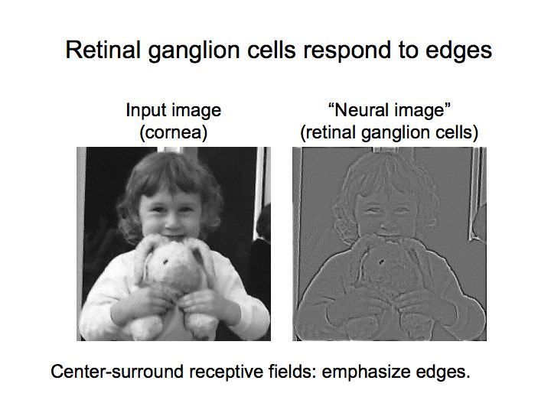
http://www.cns.nyu.edu/~david/courses/perception/lecturenotes/ganglion/ganglion.html

Slide 18
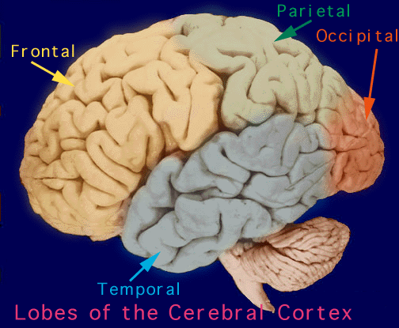
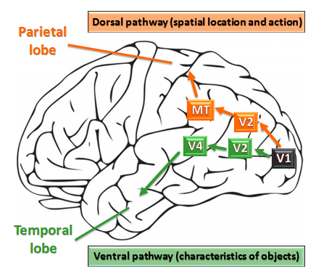
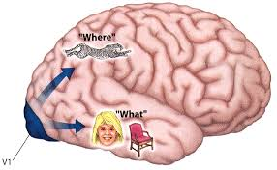
The pathways in the brain
Eyes register optical information
Two pathways from V1
“What” pathway to temporal cortex
“Where” pathway to parietal cortex
Convergence on frontal cortex
© Stephen E. Palmer, 2002
© Stephen E. Palmer, 2002

Slide 19
Feature-based Pathways Hypothesis
V2
Visual Features
Color
Shape
Depth
Motion
V1
LGN
Featural Pathways
Separate neural pathways
in which different features are
processed.
RETINA
© Stephen E. Palmer, 2002
© Stephen E. Palmer, 2002

Slide 20
Distribution of Rods and Cones
Night Sky: why are there more stars off-center?
© Stephen E. Palmer, 2002

Slide 21
Color Perception

Slide 22
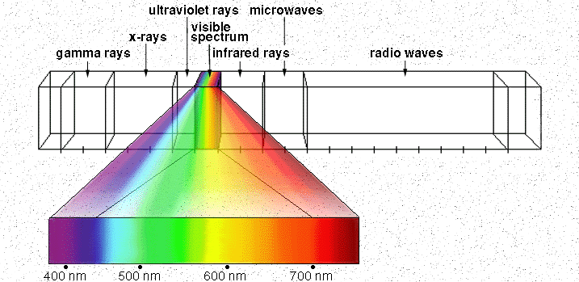
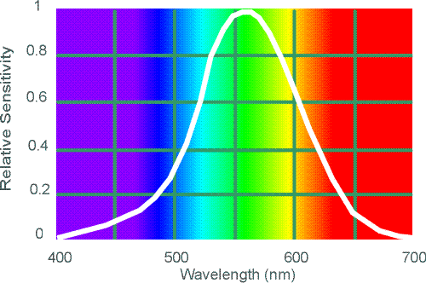
Electromagnetic Spectrum
Human Luminance Sensitivity Function
Notes:
22
At least 3 spectral bands required (e.g. R,G,B)

Slide 23
Visible Light
Why do we see light of these wavelengths?
…because that’s where the
Sun radiates EM energy
© Stephen E. Palmer, 2002

Slide 24
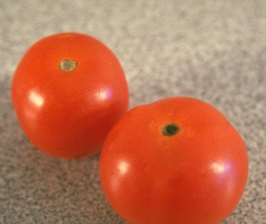
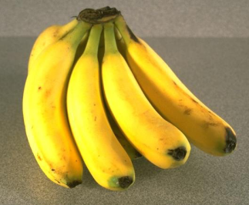
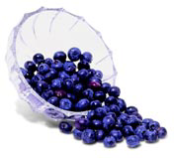
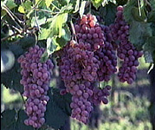
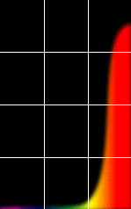
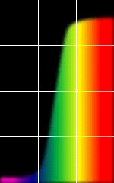
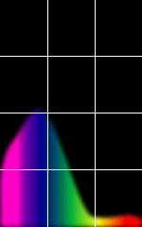
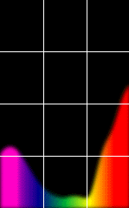
The Physics of Light
Some examples of the reflectance spectra of surfaces
Red
Yellow
Blue
Purple
% Photons Reflected
400 700
400 700
400 700
400 700
Wavelength (nm)
© Stephen E. Palmer, 2002

Slide 25
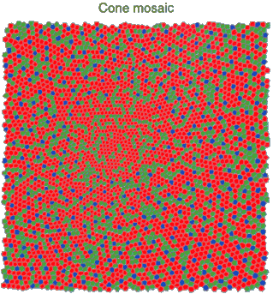
Physiology of Color Vision
Three kinds of cones:
?
© Stephen E. Palmer, 2002
Notes:
Why are M and L cones so close

Slide 26
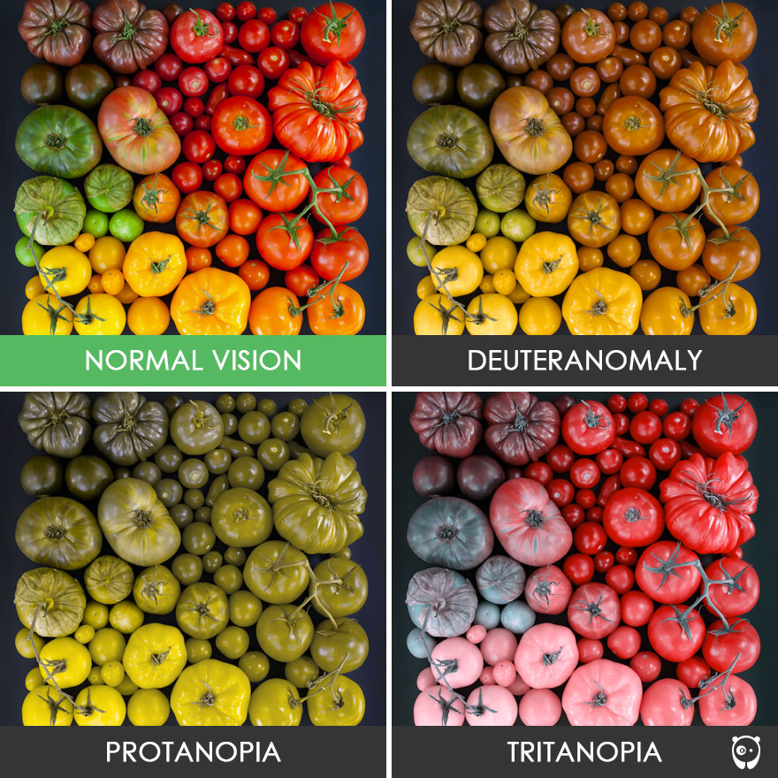
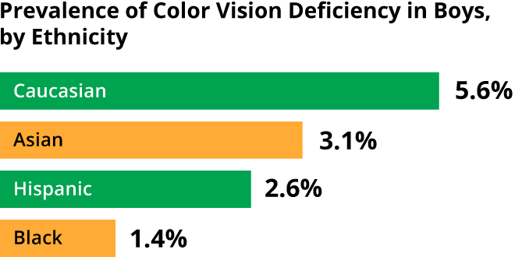
Color deficiency
4,005 California children ages 3 to 6 in Los Angeles and Riverside Counties
Xie et al.,
April 2014 in the journal Ophthalmology.
Deuteranomaly: reduced sensitivity to green light and is the most common form of colour blindness
Protanopia: reduced sensitivity to red light
Tritanopia: reduced sensitivity to blue light – extremely rae.

Slide 27
From rods and Cones to LGN and V1

Slide 28
Cortical Receptive Fields
Single-cell recording from visual cortex
David Hubel & Thorston Wiesel
https://www.youtube.com/watch?v=KE952yueVLA
© Stephen E. Palmer, 2002

Slide 29
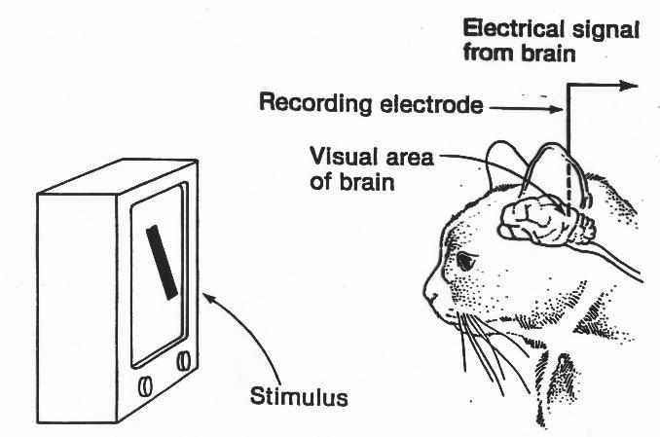
Hubel and Wiesel
http://www.cns.nyu.edu/~david/courses/perception/lecturenotes/V1/LGN-V1-slides/hw-2-cortical-rfs-640x480.mov

Slide 30
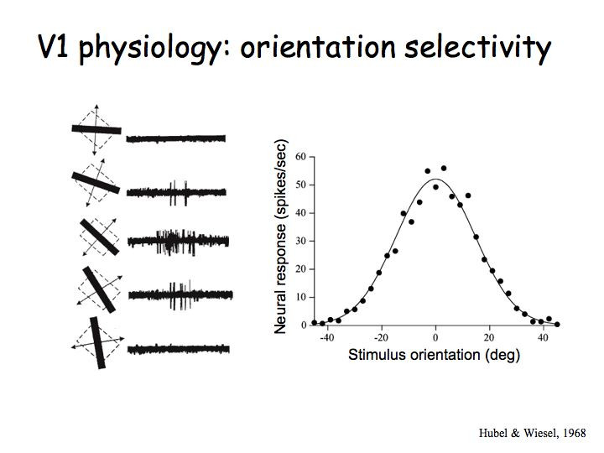
Function of the V1
David Hubel and Torsten Wiesel discovered the functional organization and basic physiology of neurons in V1.
They discovered three different types of neurons that can be distinguished based on how they respond to visual stimuli that they called: simple cells, complex cells, and hypercomplex cells.
V1 neurons transform information (unlike LGN cells whose receptive fields look just like those of ganglion cells) so that they are orientation selective and direction selective.

Slide 31
summary
The visual system is composed of
many interactive functional parts:
Eye (optics of image formation)
Retina (light transduction)
LGN (waystation?)
Area V1 (hypercolumns)
Higher cortical areas (features)
Cortical pathways (what/where)

Slide 32
Object recognition

Slide 33
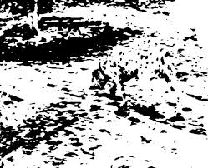

Slide 34
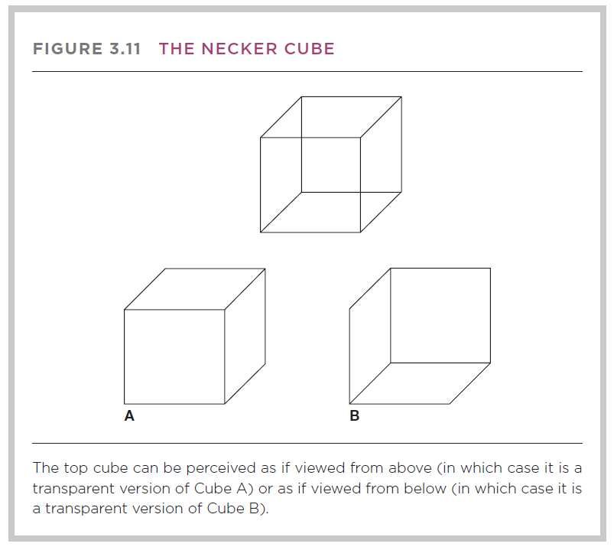
Gestalt principles of perceptual organization
The Gestaltists argued that the organization is contributed by the perceiver; this is why, they claimed, the perceptual whole is often different from the sum of its parts.

Slide 35
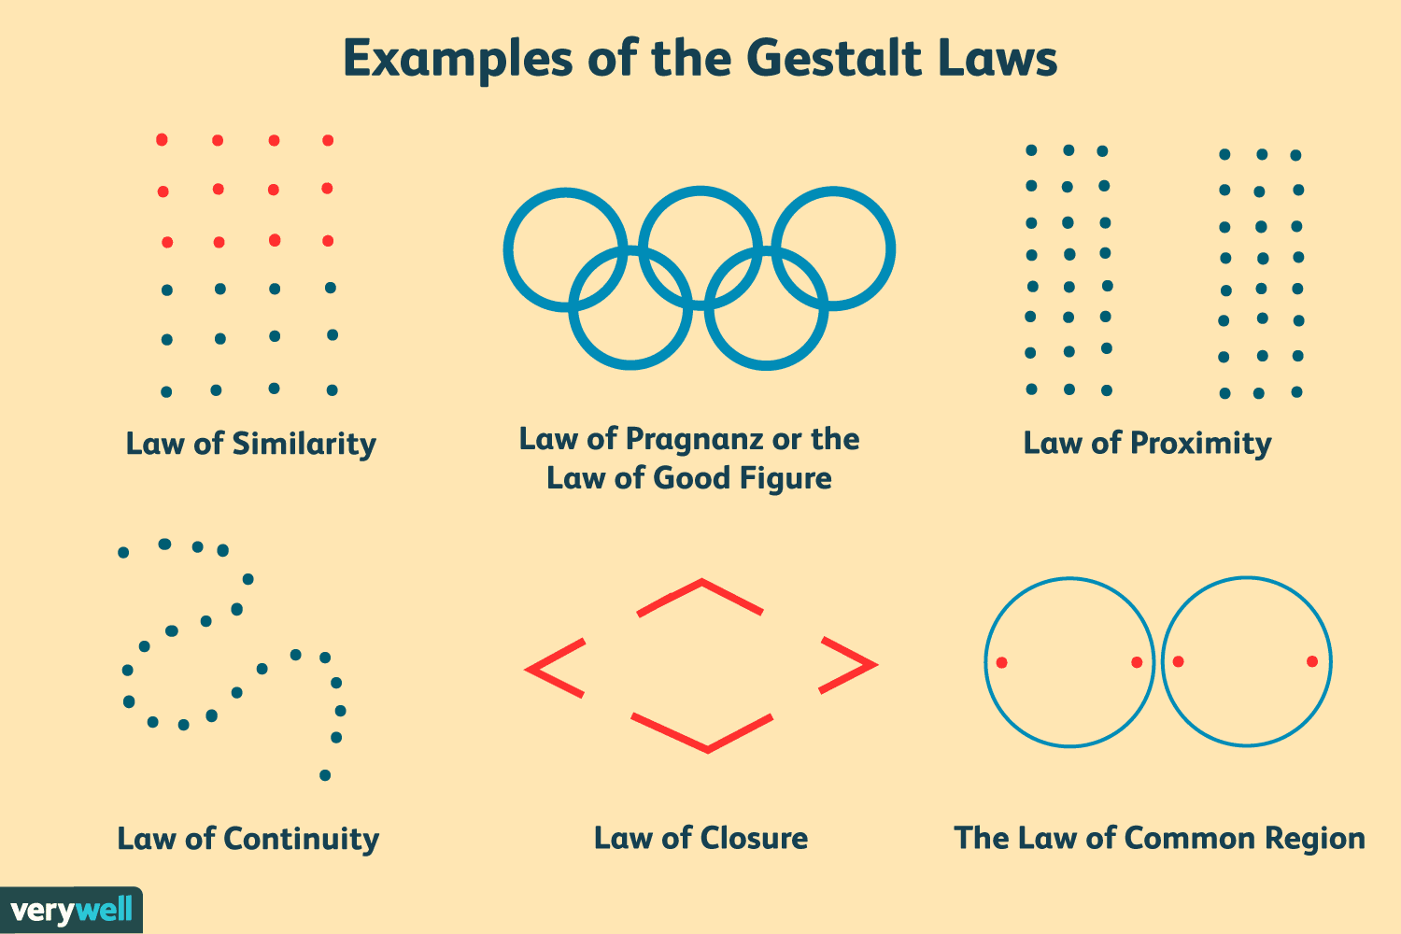
Gestalt principles

Slide 36
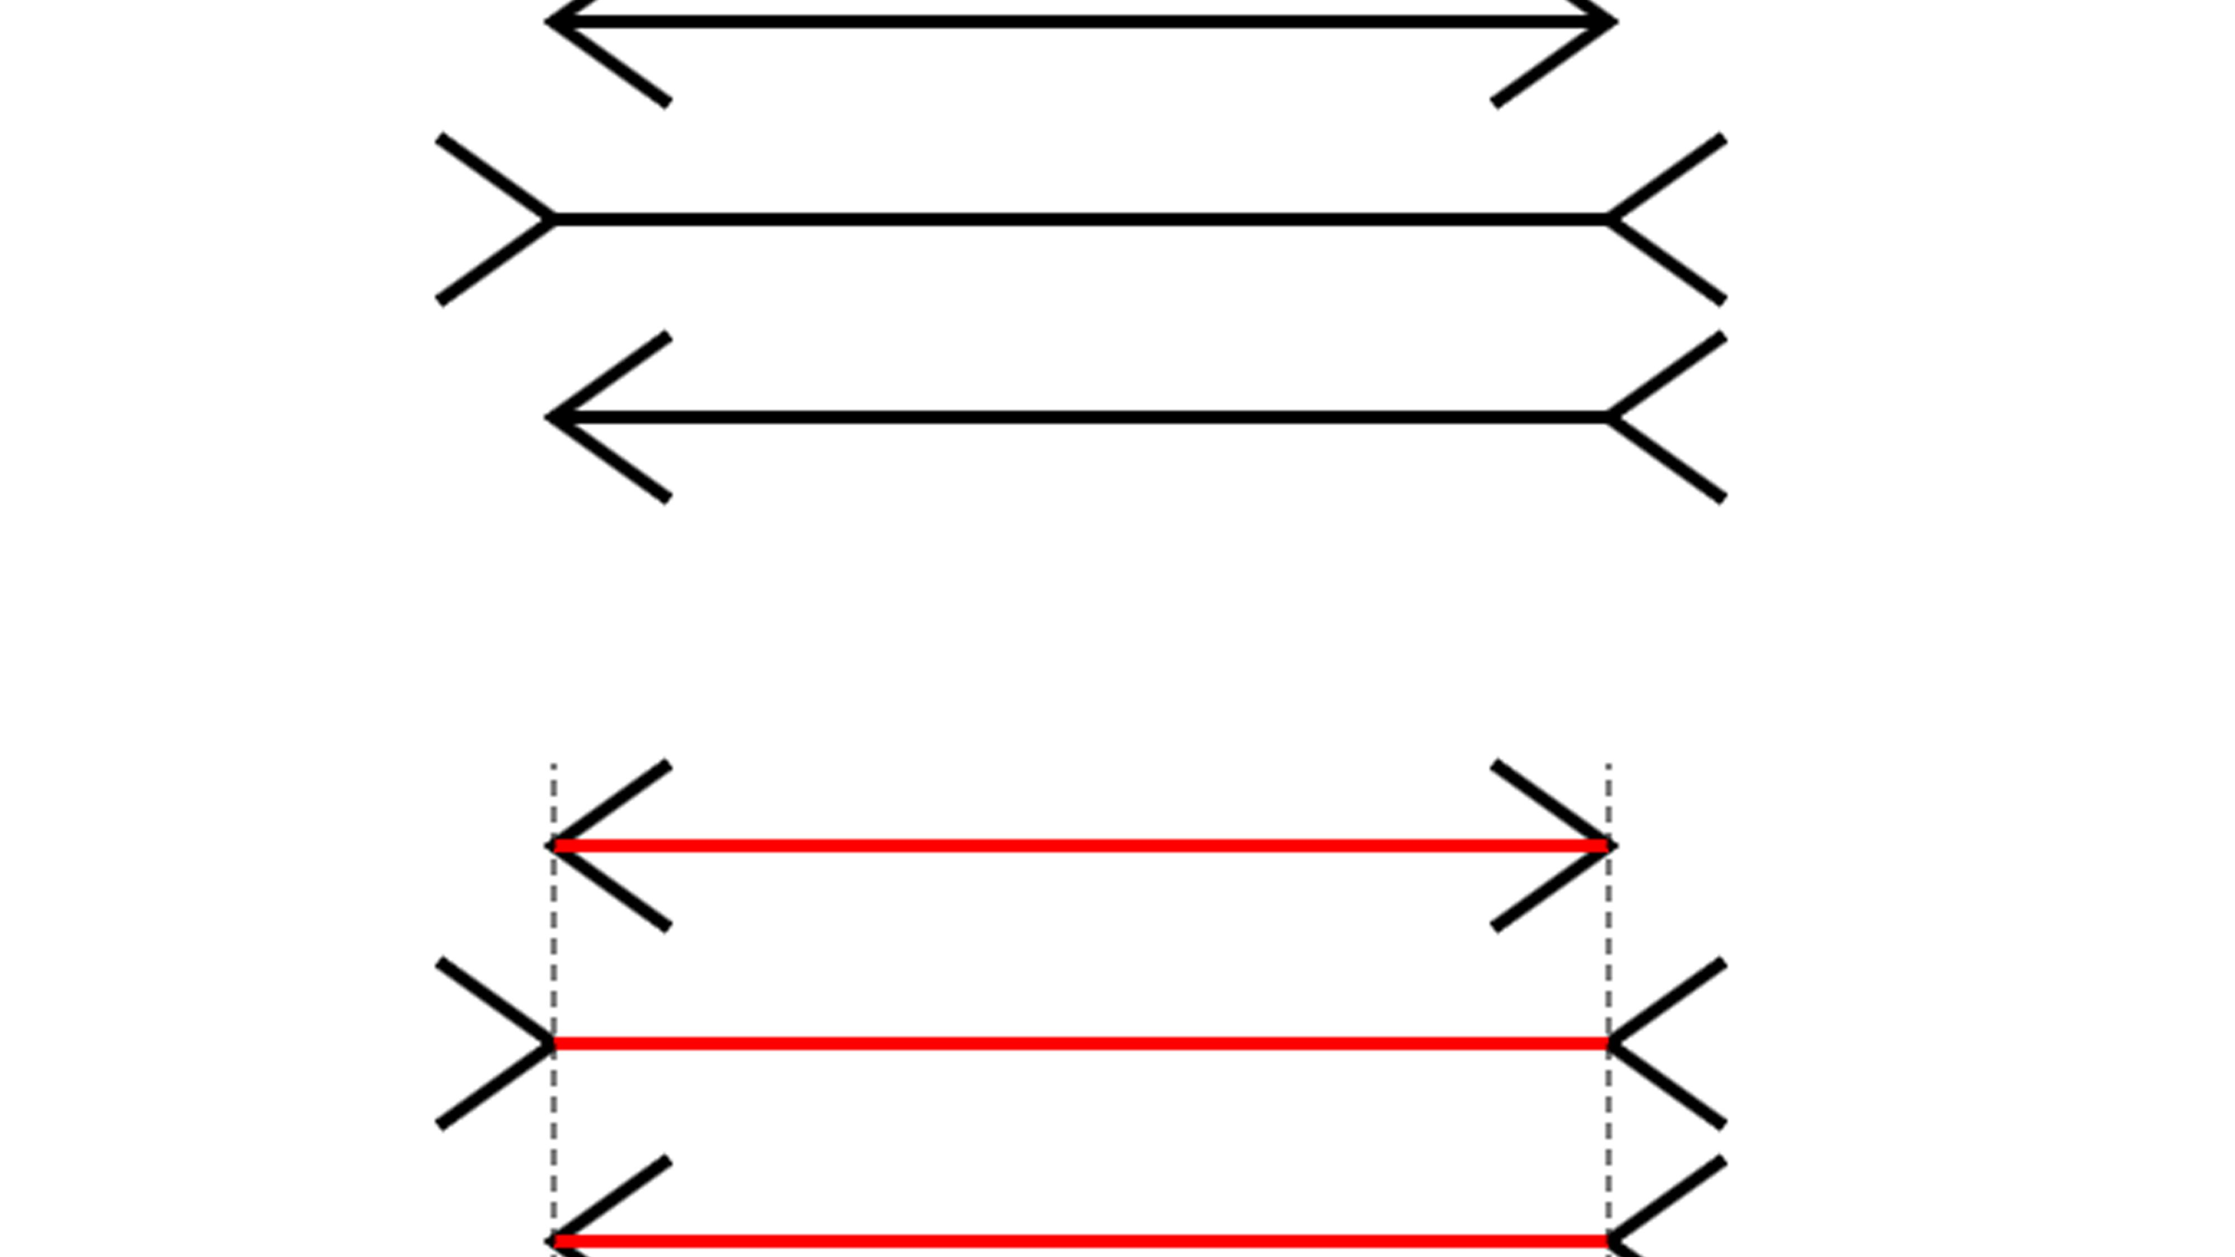
Helmholtz’s theory of unconscious inference(1867)
It states that some of our perceptions are a result of unconscious assumptions we make about the environment.
Includes the Likelihood principle – we perceive an object that is most likely to have caused the pattern.

Slide 37
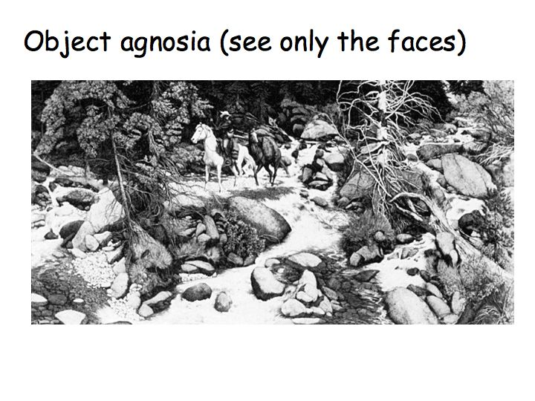
Object Recognition
How Humans Recognize Objects: Segmentation, Categorization and Individual Identification

Slide 38
How Do We Recognize Objects From Different Viewpoints?
Two competing theories:
- Structural description models
- Image description models

Slide 39
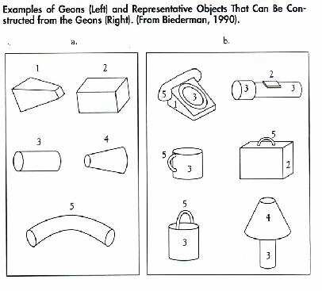
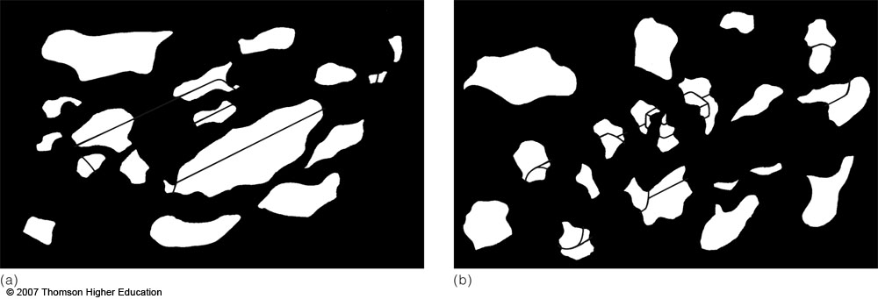
Structural-Description Models:
Recognition by Components (RBC) {Biederman (1985)}
Geons (“Geometric Ions”)
Each geon is uniquely identifiable from most viewpoints (viewpoint invariant).
Only 36 geons needed to make thousands of objects.
Objects can be identified if the geons can be identified:
which geons are present?
what is the spatial relation among geons?
Figure 5.35 (a) It is difficult to identify the object behind the mask because its geons have been obscured.
(b) Now that it is possible to identify geons, the object can be identified as a flashlight.

Slide 40
Recognition by Components
Strengths
– Viewpoint invariant
– Parts-based
– May be able to deal with partial occlusion via feedback
– Represent 3-D structure
Weaknesses
– Complexity of representation
– Doesn’t easily represent subtle metric differences (e.g.,distance between eyes)
– Recognition is at the level of categories (chair vs. table) rather than individuals (my office chair vs. my kitchen chair)

Slide 41
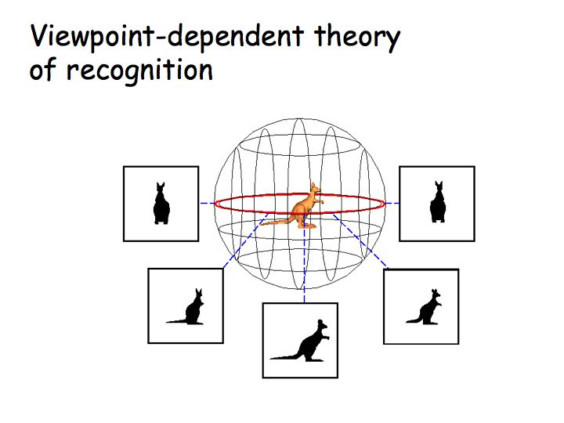
This is an alternative theory. You store in your head a bunch of characteristic views (mental images) of objects. You recognize a new image by finding the closest match. That is, you don't use 3D shape to recognize objects. Only the 2D views of the objects

Slide 42
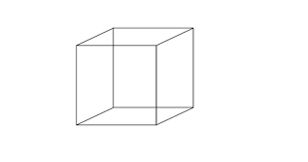
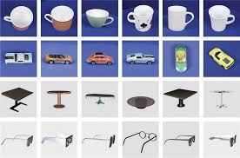
Image-Description Models
Ability to identify 3-D objects comes from stored 2-D viewpoints from different perspectives
– For a familiar object, view invariance occurs
– For a novel object, view invariance does not occur
This shows that an observer needs to have the different viewpoints encoded before recognition can occur from all viewpoints

Slide 43


Slide 44
Object recognition
Schneider’s (1969) suggestion that two distinct pathways support visual orientation toward object features.
Research stemming from this idea has inextricably linked object recognition to the experiences of space, time, and persistence over time, i.e., individual identity ( Scholl, 2007; Fields, 2012 ).
Without a spacetime “container” and individual, time-persistent objects, motion and causation cannot be defined; hence object recognition underlies these experiences as well.
Will object recognition be possible without memory?
https://www.frontiersin.org/articles/10.3389/fpsyg.2016.00400/full

Slide 45
Object Recognition
Researchers in one study were able to do single-cell recording within the brains of people who were undergoing surgical treatment for epilepsy. The researchers located cells that fired strongly whenever a picture of Jennifer
Aniston was in view — whether the picture showed her close up (picture 32) or far away (picture 29), with long hair (picture 32) or shorter (picture 5). These cells are largely viewpoint-independent; other cells, though, are viewpoint-dependent.

Slide 46
Pattern Recognition
Face,Speech/music,text, art
Theories of pattern recognition:
1. Template-matching theory.
2. Feature detection theories
3. Prototype theories
Prototype theory is preferred, because (a) it appears to be amore flexible approach (since prototypes can be updated continuously with new experiences), and (b) fewer representations need to be stored.
Extreme cases:
Apophenia (early stages of schizophrenia).
Pareidolia: ringing phone while taking a shower.
Gambler's fallacy: school oneself to see patterns

Slide 47

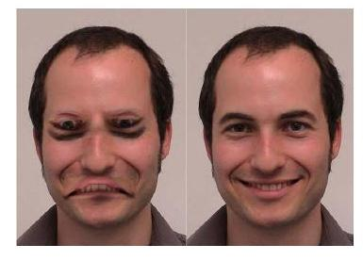
Pattern Invariance- Pattern recognition

Slide 48
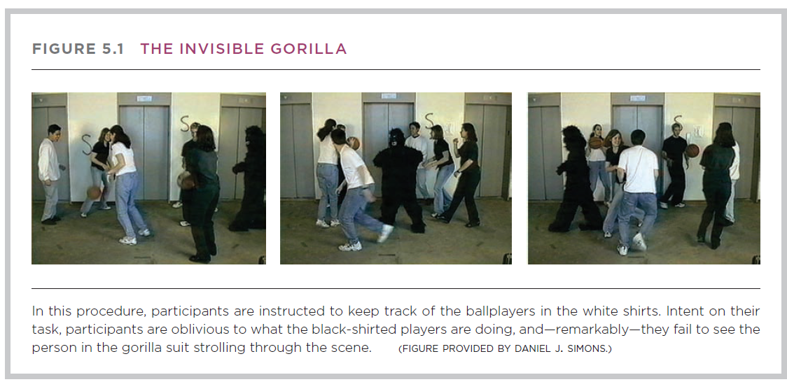
Attention

Slide 49
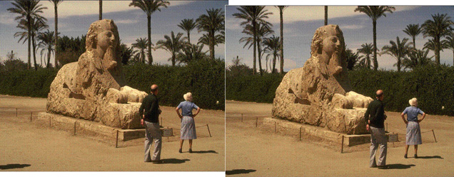
Change Blindness

Slide 50
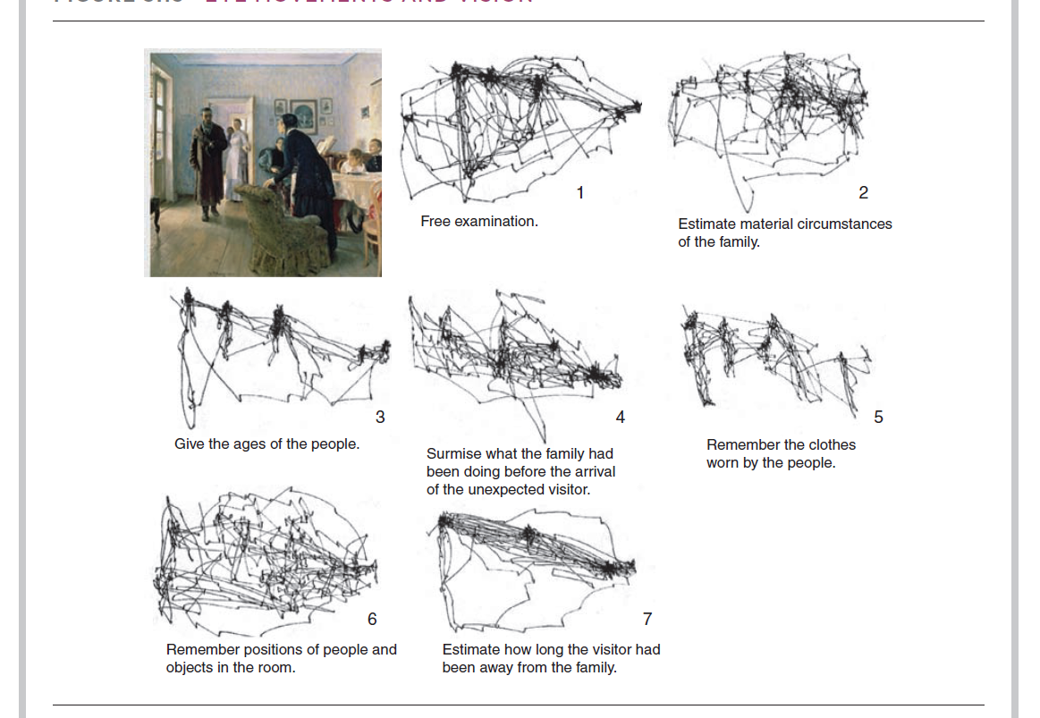
Eye movements and vision

Slide 51
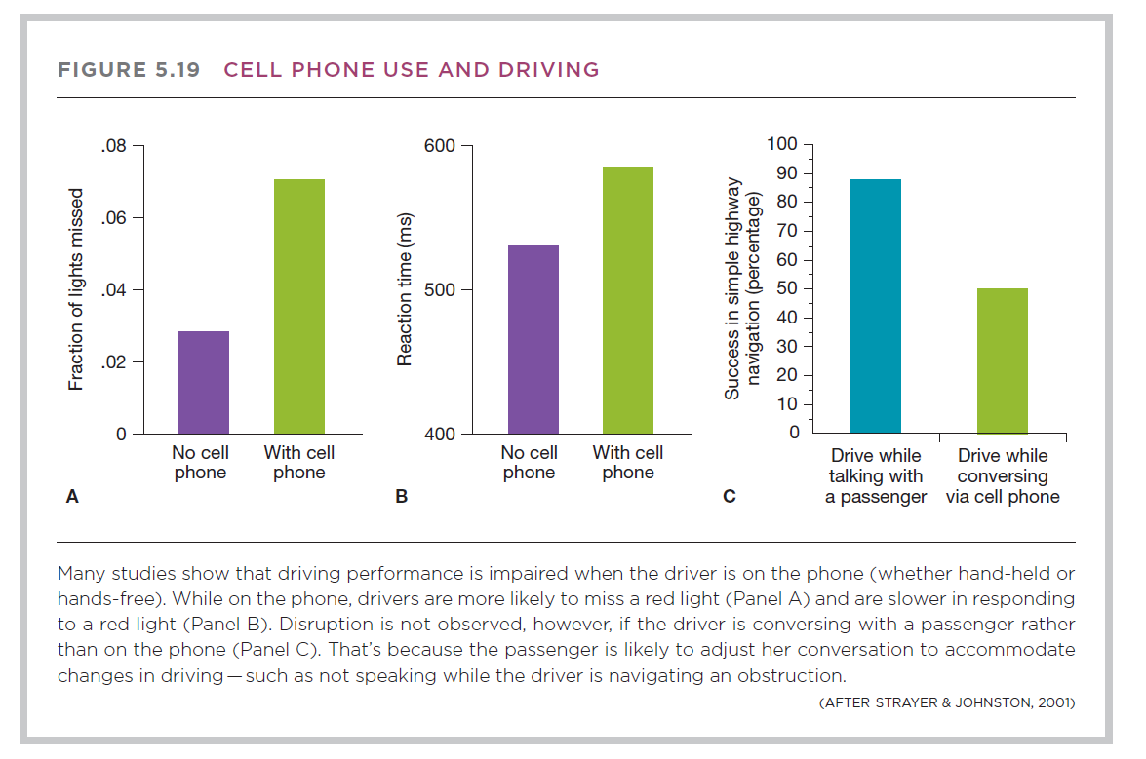
Multitasking & Attention

Slide 52
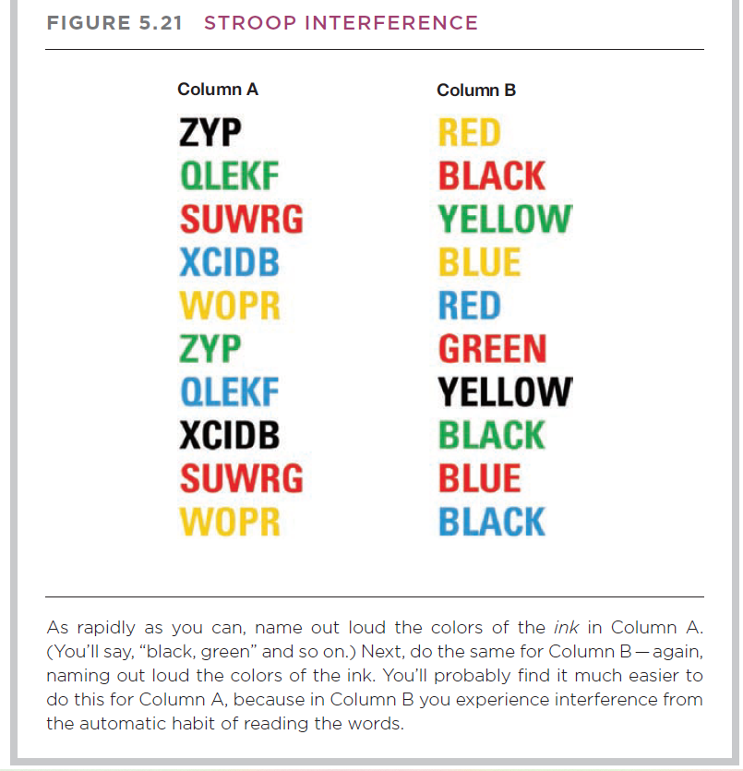

Slide 53
Alan Burgess
hemispatial neglect – an inability to pay attention to sensory stimuli on his left side .
Stroke damaged the parietal lobe on the right side of his brain, the part that deals with the higher processing of attention. The damage causes him to ignore people, sounds, and objects on his left.
research suggests that people with normal vision perform better at visual attention tasks when they are rewarded for good performance and Dr Malhotra and his team have found the same thing in neglect patients.
Dr Paresh Malhotra, senior lecturer in neurology at Imperial College London

Slide 54
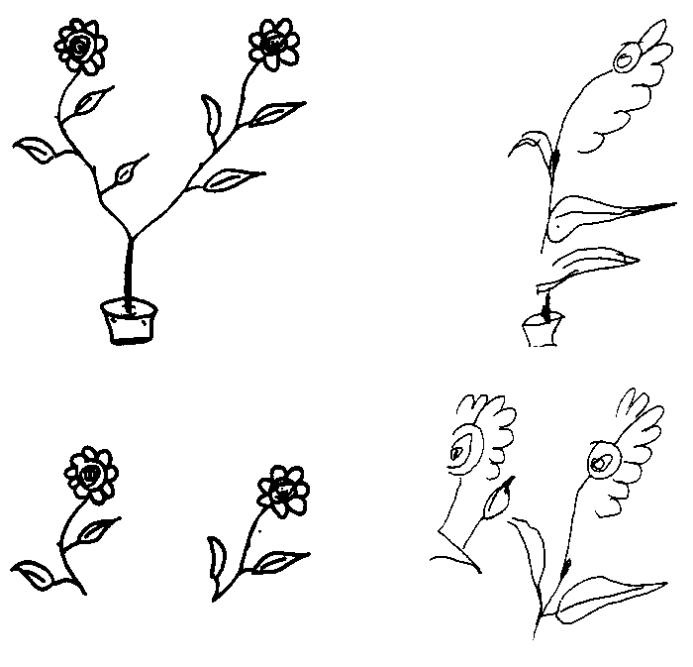
Object-centred Neglect
Object and Location-based Neglect
Notes:
The copy on the bottom left shows object-centred, but not location-centred, neglect. The patient copies half of each object in both visual fields
The copy on the bottom right shows object-centred neglect (copies only half of one flower) but also location-centred neglect -- omitting the flower on the left entirely.

Slide 56
Reconstructing shape from movement
Johansson (1973)
https://www.youtube.com/watch?v=rEVB6kW9p6k
Notes:
56

Slide 57

What/Where Pathways Evidence from Neuropsychology
Visual agnosia: apperceptive agnosia (features) and associative agnosia (meaning).
Inability to identify objects and/or people
Caused by damage to inferior (lower) temporal lobe
Disruption of the “what” pathway
https://www.youtube.com/watch?v=ze8VVtBgK7A
Face recognition – prosopagnosia.
2006 study revealed that about one in 50 Americans is affected by Prosopagnosia.
https://www.youtube.com/watch?v=-vQGPcYfIAo
https://www.youtube.com/watch?v=vwCrxomPbtY

